Slide 1
Part 1
Introduction to Information Retrieval (IR)
What is Information Retrieval?
What is IR about?
How is IR related to Information Science

Slide 2
Introduction
Weimao Ke
wk@drexel.edu

Slide 3
Information Retrieval
Mooers (1951) coined Information Retrieval:
The investigation of information description and specification for search and techniques for search operations. (see also Saracevic, 1999)
Mooers’ Law (1959) [NOT the Moore's law]
“An information retrieval system will tend NOT to be used whenever it is more painful and troublesome for a customer to have information than for him not to have it.”

Slide 4
IR and Information Science
Baeza-Yates and Ribeiro-Neto (2004):
Information Retrieval (IR) “deals with the representation, storage, organization of, and access to information items.”
Considered an important area of Information Science
Information Science is about “gathering, organizing, storing, retrieving, and dissemination of information.” (Bates, 1999)
IR has a long tradition and root in Information & Library Science
Computer science has strong influence on system-centric IR

Slide 5

IR to Information Science
Saracevic (1999):
“Surely, information science is more than IR, but many of the problems raised by IR or derived from objects and phenomena involved in IR, are at its core.”

Slide 6
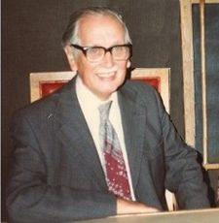
Cranfield Tests and IR Tradition
Cranfield tests
A series of early experiments
led by Cyril W. Cleverdon (a librarian, see picture :)
at College of Aeronautics at Cranfield
on retrieval effectiveness of index languages/techniques
The tests established an experimental IR tradition
A document collection
A set of queries
Relevance judgment
Evaluation metrics, e.g., precision and recall

Slide 7
IR Tradition continues
The Text Retrieval Conference (TREC)
A platform where IR systems can compete/be compared
Large scale evaluation
Various “tracks” beyond text retrieval
Each TREC track, e.g., Web track for IR on the Web
A benchmark document collection (e.g., web pages)
Pre-defined tasks and queries
A common relevance base (manually judged by humans)
Standardized evaluation procedures and metrics

Slide 8
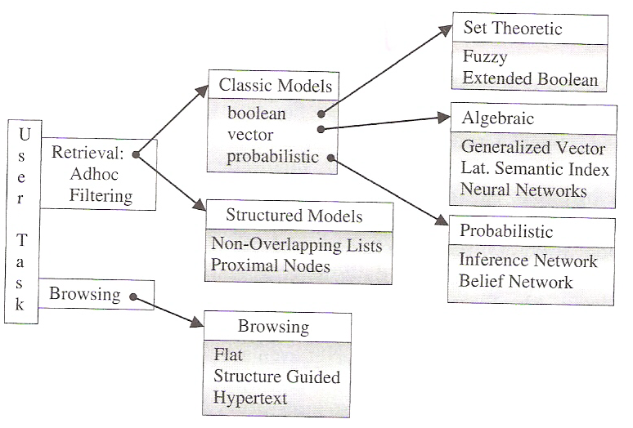
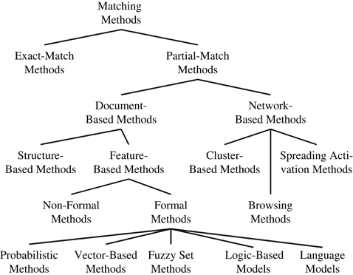
Information Retrieval Models
IR model taxonomy
Another taxonomy
Jarvelin, K. (2007)
Baeza-Yates andRibeiro-Neto (2004)

Slide 9
Information Retrieval
Back to the MRS book
A simplified view of IR
Manning, Raghavan, and Schütze (2008):
Information Retrieval (IR) is finding material (usually documents) of an unstructured nature (usually text) that satisfies an information need from within large collections (usually stored on computers).

Slide 10
Basic assumptions of Information Retrieval
Sec. 1.1
Collection: Fixed set of documents
Goal: Retrieve documents with information that is relevant to the user’s information need and helps the user complete a task
Relevance is a key notion in IR but remains one of the LEAST understood concepts in the field.

Slide 11
Put relevance aside
Let’s start discussions on retrieval algorithms with a basic searching (matching) problem without worrying about what exactly relevance is.

Slide 12
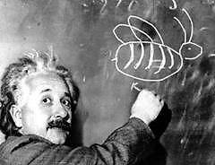
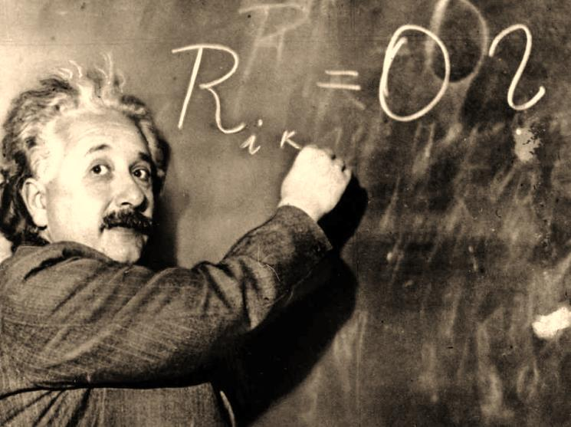
IR and Math
Yes, there is math…
But
“Do not worry about your difficulties in Mathematics. I can assure you mine are still greater.”

Slide 13
Part 2
Boolean Model
Document-term Matrix
Inverted Index

Slide 14
Unstructured data in 1680
Sec. 1.1
Collection
Shakespeare’s Collected Works
Information need:
Which plays of Shakespeare contain the words Brutus AND Caesar but NOT Calpurnia?
One could grep all of Shakespeare’s plays for Brutus and Caesar, then strip out lines containing Calpurnia?
Sequential search
Why is that not the answer?
Slow (for large corpora)
https://www.kaggle.com/kingburrito666/shakespeare-plays
Notes:
Grep is line-oriented; IR is document oriented.

Slide 15
Term-document incidence matrix
Sec. 1.1
1 if play contains word, 0 otherwise
Brutus AND Caesar BUT NOT Calpurnia

Slide 16
Incidence vectors
Sec. 1.1
So we have a 0/1 vector for each term.
To answer query: take the vectors for Brutus, Caesar and Calpurnia (complemented) ➔ bitwise AND.
110100 AND 110111 AND 101111 = 100100.

Slide 17
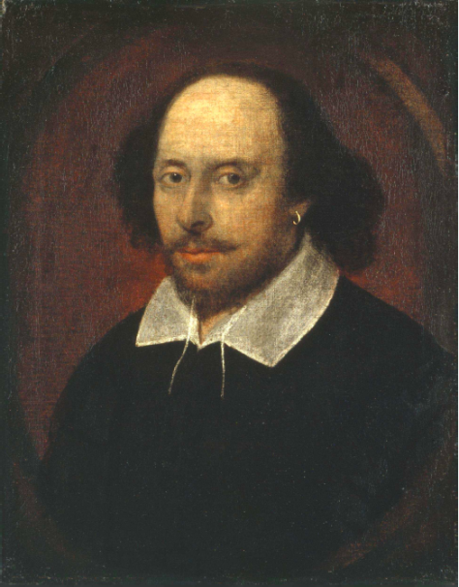
Answers to query
Sec. 1.1
Antony and Cleopatra, Act III, Scene ii
Agrippa [Aside to DOMITIUS ENOBARBUS]: Why, Enobarbus,
When Antony found Julius Caesar dead,
He cried almost to roaring; and he wept
When at Philippi he found Brutus slain.
Hamlet, Act III, Scene ii
Lord Polonius: I did enact Julius Caesar I was killed i' the
Capitol; Brutus killed me.

Slide 18
Bigger collections
Sec. 1.1
Consider N = 1 million documents, each with about 1000 words.
Avg 6 bytes/word including spaces/punctuation
6GB of data in the documents.
Say there are M = 500K distinct terms among these.

Slide 19
Can’t build the matrix
Sec. 1.1
500K x 1M matrix has half-a-trillion 0’s and 1’s.
But it has no more than one billion 1’s.
matrix is extremely sparse.
What’s a better representation?
We only record the 1 positions.
Why?

Slide 20
Inverted index
Sec. 1.2
For each term t, we must store a list of all documents that contain t.
Identify each by a docID, a document serial number
Brutus
1
2
4
11
31
45
173
174
Caesar
1
2
4
5
6
16
57
132
Calpurnia
2
31
54
101

Slide 21
Inverted index
Sec. 1.2
We need variable-size postings lists
On disk, a continuous run of postings is normal and best
In memory, can use linked lists or variable length arrays
Some tradeoffs in size/ease of insertion
Posting
Brutus
1
2
4
11
31
45
173
174
Caesar
1
2
4
5
6
16
57
132
Calpurnia
2
31
54
101
Dictionary
Postings
Sorted by docID (more later on why).
Notes:
Linked lists generally preferred to arrays
Dynamic space allocation
Insertion of terms into documents easy
Space overhead of pointers

Slide 22





Inverted index construction
Sec. 1.2
Documents to
be indexed.
Friends, Romans, countrymen.
Tokenizer
Token stream.
Friends
Romans
Countrymen
More on
these later.
Linguistic modules
Modified tokens.
friend
roman
countryman
Indexer
friend
2
4
roman
1
2
Inverted index.
countryman
13
16

Slide 23
Indexer steps: Token sequence
Sec. 1.2
Sequence of (Modified token, Document ID) pairs.
Doc 1
Doc 2
I did enact Julius
Caesar I was killed
i' the Capitol;
Brutus killed me.
So let it be with
Caesar. The noble
Brutus hath told you
Caesar was ambitious

Slide 24
Indexer steps: Sort
Sec. 1.2
Sort by terms
And then docID
Core indexing step

Slide 25
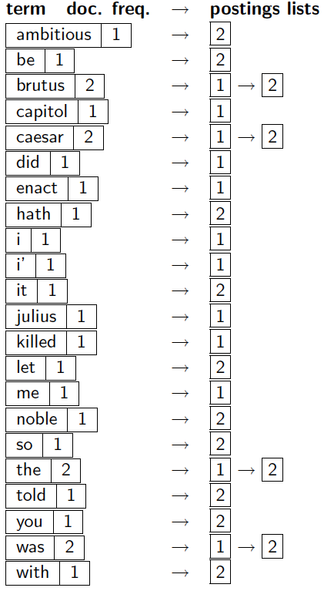
Indexer steps: Dictionary & Postings
Sec. 1.2
Multiple term entries in a single document are merged.
Split into Dictionary and Postings
Doc. frequency information is added.
Why frequency?
Will discuss later.

Slide 26
Exercise
Given the following collection of documents
Doc 1: new home sales top forecasts
Doc 2: home sales rise in july
Doc 3: increase in home sales in july
Doc 4: july new home sale rise
Tasks
Draw the inverted index
Draw the term-document incidence matrix

Slide 27
Results
Term | DF | Posting
forecasts |  | 1
home |  | 1 | 2 | 3 | 4
in |  | 2 | 3
increases |  | 3
july |  | 2 | 3 | 4
new |  | 1
rise |  | 2 | 4
sales |  | 1 | 2 | 3 | 4
top |  | 1

Slide 28
Results with Document Freq. values
Term | DF | Posting
forecasts | 1 | 1
home | 4 | 1 | 2 | 3 | 4
in | 2 | 2 | 3
increases | 1 | 3
july | 3 | 2 | 3 | 4
new | 1 | 1
rise | 2 | 2 | 4
sales | 4 | 1 | 2 | 3 | 4
top | 1 | 1

Slide 29
QUERY PROCESSING

Slide 30
The index we just built
Sec. 1.3
How do we process a query?

Slide 31
Query processing: AND
Sec. 1.3
Consider processing the query:
Brutus AND Caesar
Locate Brutus in the Dictionary;
Retrieve its postings.
Locate Caesar in the Dictionary;
Retrieve its postings.
“Merge” the two postings:
2
4
8
16
32
64
128
Brutus
1
2
3
5
8
13
21
34
Caesar

Slide 32
The merge
Sec. 1.3
Walk through the two postings simultaneously, in time linear in the total number of postings entries
2
2
4
4
8
8
16
16
32
64
128
32
64
128
Brutus
2
8
1
Caesar
1
2
2
3
5
5
8
8
13
13
21
21
34
3
34
If the list lengths are x and y, the merge takes O(x+y)
operations.
Crucial: postings sorted by docID.

Slide 33
Boolean queries: Exact match
Sec. 1.3
The Boolean retrieval model is being able to ask a query that is a Boolean expression:
Boolean Queries are queries using AND, OR and NOT to join query terms
Views each document as a set of words
Is precise: document matches condition or not.
Perhaps the simplest model to build an IR system on
Primary commercial retrieval tool for 3 decades.
Many search systems you still use are Boolean:
Email, library catalog, Mac OS X Spotlight

Slide 34
Query optimization
Sec. 1.3
What is the best order for query processing?
Consider a query that is an AND of n terms.
For each of the n terms, get its postings, then AND them together.
Brutus
2
4
8
16
32
64
128
Caesar
1
2
3
5
8
16
21
34
Calpurnia
13
16
Query: Brutus AND Calpurnia AND Caesar
34

Slide 35
Query optimization example
Sec. 1.3
Process in order of increasing freq:
start with smallest set, then keep cutting further.
This is why we kept
document freq. in dictionary
Brutus
2
4
8
16
32
64
128
Caesar
1
2
3
5
8
16
21
34
Calpurnia
13
16
Execute the query as (Calpurnia AND Brutus) AND Caesar.

Slide 36
More general optimization
Sec. 1.3
(…) AND (…) AND (…)
Steps:
Get document frequencies for all terms in the query
Estimate document frequency for each component of AND (in parentheses)
Merge their postings in increasing order of document frequency
Note: posting length == document frequency

Slide 37
Example
Query for the exercise collection
“home” AND “increase” AND NOT “july”
Term | DF | Posting
forecasts | 1 | 1
home | 4 | 1 | 2 | 3 | 4
in | 2 | 2 | 3
increases | 1 | 3
july | 3 | 2 | 3 | 4
new | 1 | 1
rise | 2 | 2 | 4
sales | 4 | 1 | 2 | 3 | 4
top | 1 | 1

Slide 38
Example (cont.)
DF values of the terms
Home: 4
Increase: 1
July: 3
There are 4 documents in the example collection
So, DF values of the query components:
Home: 4
Increase: 1
NOT july: 1 (i.e., #total docs - #docs “july” appears = 4 – 3)
Optimized query processing order: process (increase AND not july) first and then AND home
In the increasing order of document frequency (DFs)

Slide 39
Ranking search results
Boolean queries give inclusion or exclusion of docs.
Often we want to rank/group results
Need to measure proximity from query to each doc.
Need to decide whether docs presented to user are singletons, or a group of docs covering various aspects of the query.

Slide 40
More…
Introduction to Information Retrieval, MRS chapter 1
Any questions?
You may email your instructor and/or post your questions to the discussion board.

